Slide 1


GEOG 178/258:
Conceptual Modeling and Programming for the Geo-Sciences
Week 1: March 31st, 2020
mike johnson

Slide 2
Instructor: Krzysztof Janowicz
Lecture/Lab: Friday 9:00 – 11:50
Office hours:
Monday 10:30am – 11:30am
jano@ucsb.edu
Week
1
Logistics
TA: Mike Johnson
Section: Tuesday 11:00 – 12:50
Office hours:
TBD
jmj00@ucsb.edu
Section Website:
https://mikejohnson51.github.io/geog178

Slide 3
1. Getting the Class Website on your machines…

Slide 4
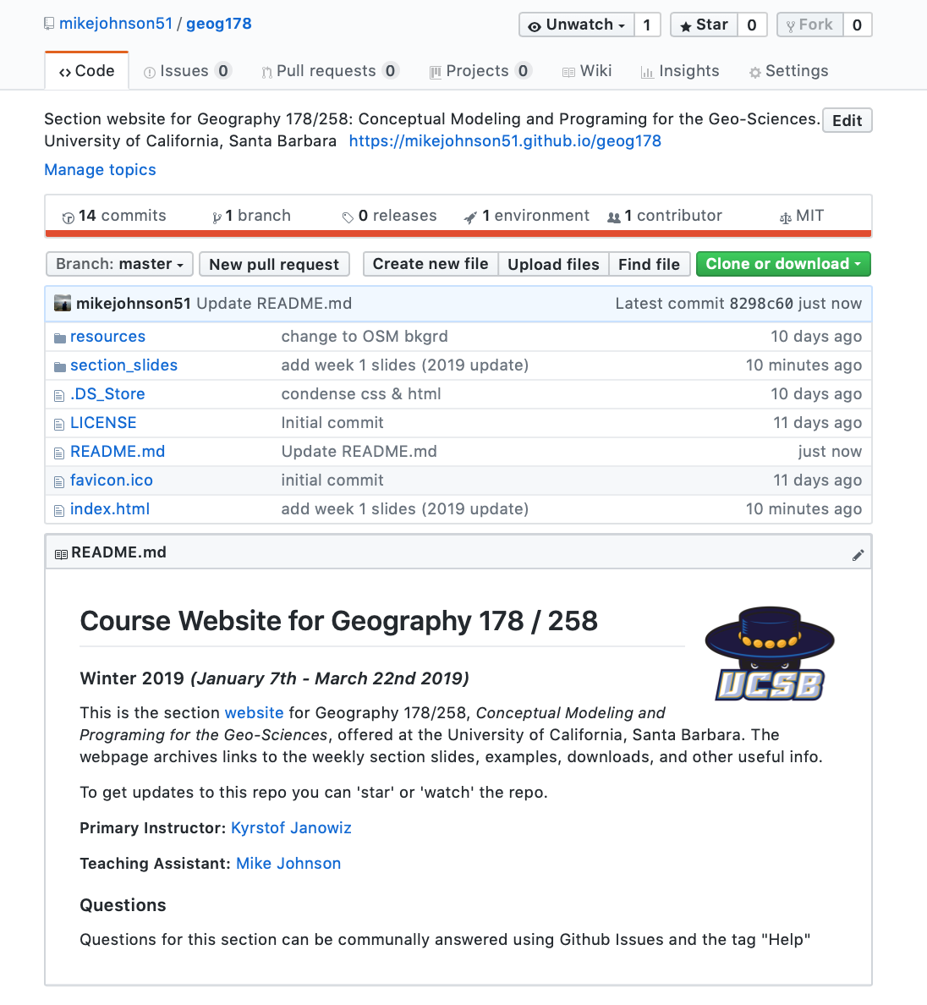
Getting started with GitHub
Section repository:
https://github.com/mikejohnson51/geog178
Week
1
Class Website
Github
Reasons for this:
* build familiarity (for you as developing programmers),
* force getting started with version control, open coding
* host a class community,
* longevity of material,
* improve group work in second half of class,

Slide 5
Getting started with GitHub
This is all optional and not needed to complete the class but will hopefully make your life easier in the long run…
Make a GitHub account at: https://github.com
Find the class repository searching for ‘geog178’
‘Star’ to be easily found and to easily find the repo
‘Watch’ to be notified of changes such as new issues, new content, ect.
‘Fork’ to make a copy of the repo in your own account
Week
1
Class Website
Github

Slide 6
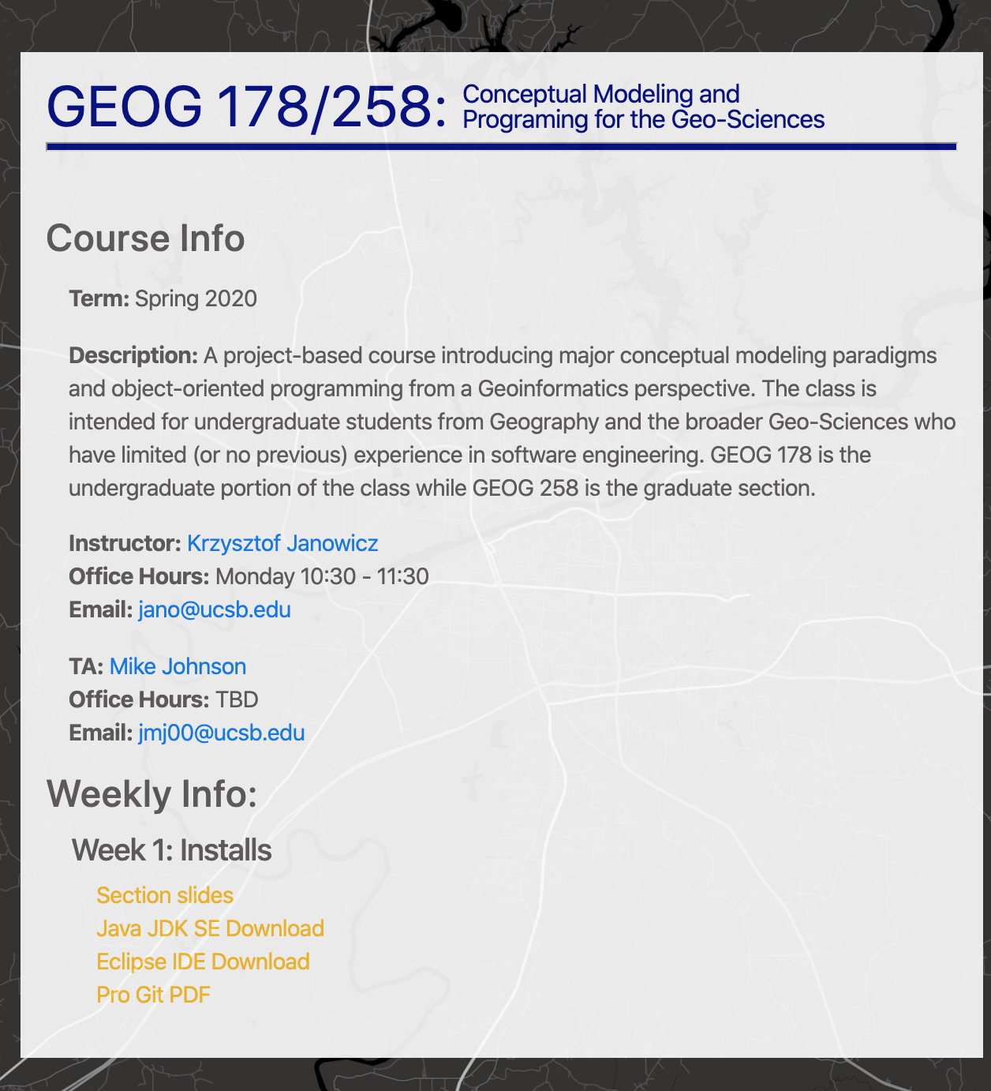
Getting started with Github
All GitHub repo’s can host a static website…
Ours is here: https://mikejohnson51.github.io/geog178
Week
1
Class Website
Github

Slide 7
2. Getting Eclipse set up on your machines…

Slide 8
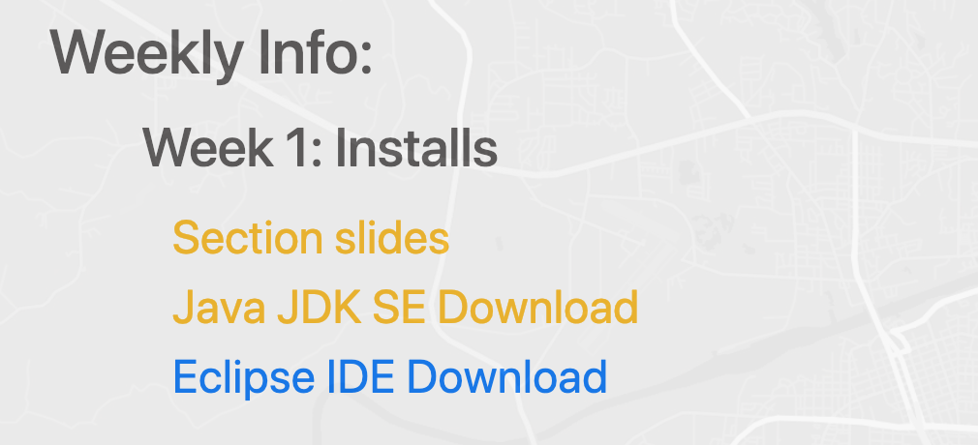
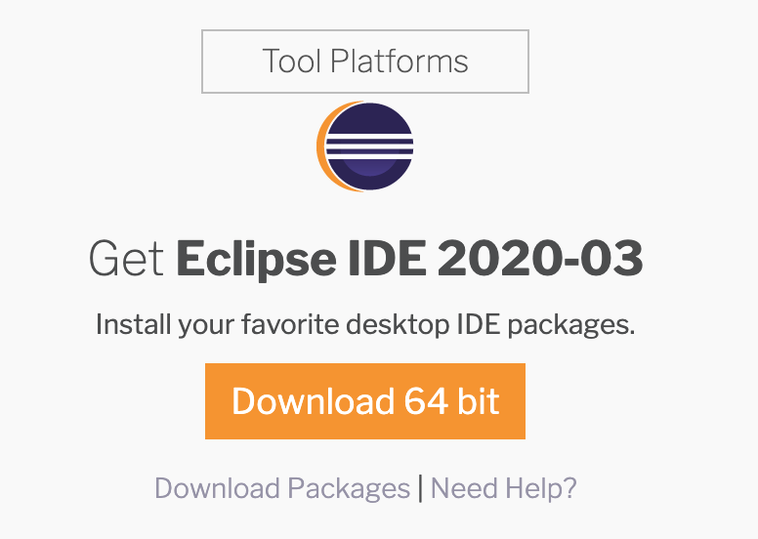
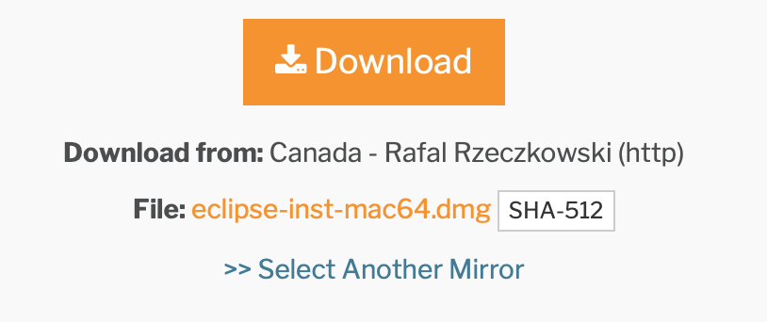
Necessary Downloads:
1. To get set up on a personal machine, you need the Eclipse Program files. They can be found here:
https://www.eclipse.org/downloads/
Or through the section website:
2. From the Eclipse main page download the zip file from the series of download buttons:
Week
1
Getting Started with Eclipse
https://mikejohnson51.github.io/geog178

Slide 9
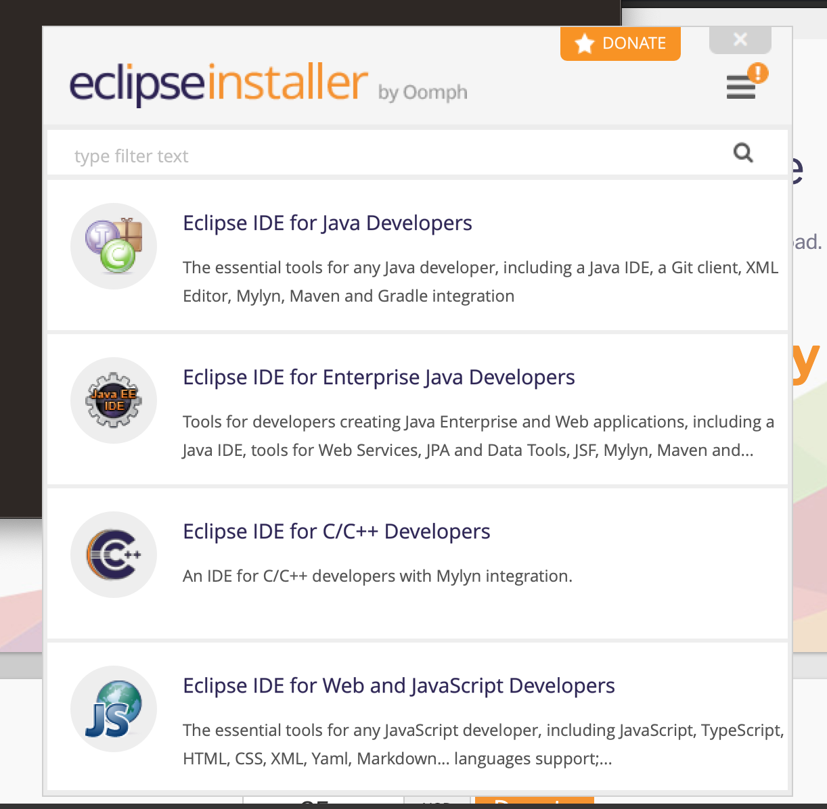
Eclipse “Flavor”:
Week
1
Getting Started with Eclipse

Slide 10
Installing
From the unzipped download folder try and install Eclipse
On Windows → select the ‘eclipse-inst-win64.exe’ file
On Mac → select the ‘eclipse-inst-mac64.tar.gz’ file
Follow all instructions
…. Does it Error Out???
Eclipse is written in Java so you may need to download the Java SE JDK** if it is not already on your machine
Week
1
Getting Started with Eclipse
**JDK: Java Development Toolkit which includes JRE (Java Runtime Environment), an interpreter/loader (java), a compiler (javac), an archiver (jar) and a documentation generator (javadoc)
https://mikejohnson51.github.io/geog178

Slide 11
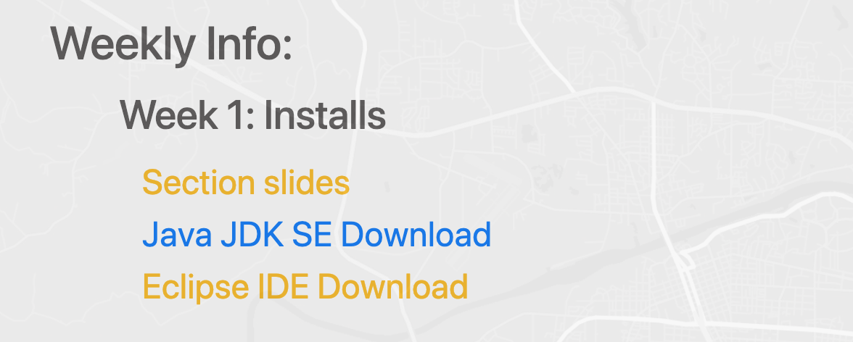
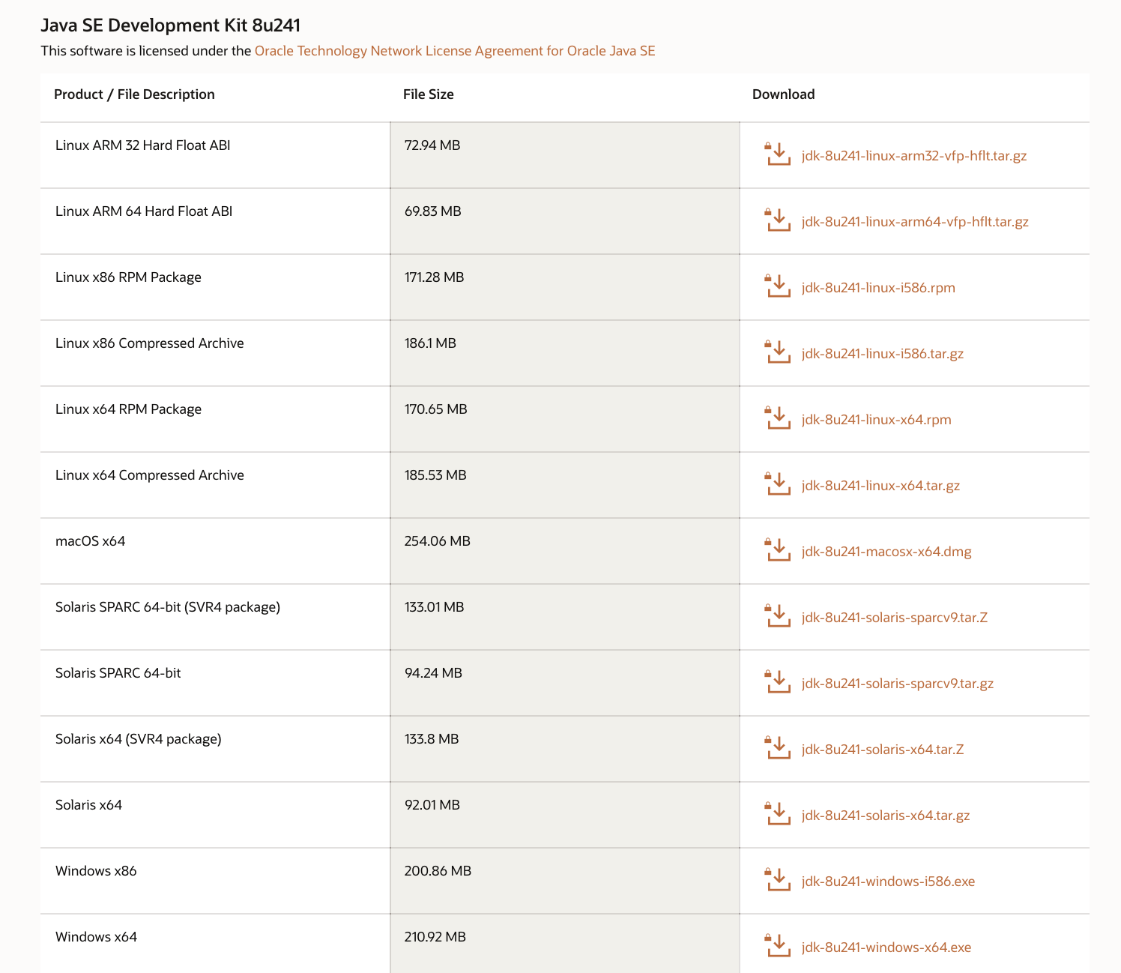
Installing Java JDK
1. The Java SE JDK download can be found here:
https://www.oracle.com/java/technologies/javase-jdk8-downloads.html
Or on the section webpage:
2. Select the needed program file from the list of options:
Week
1
Getting Started with Eclipse
macOS.x64
Windows.x64
3. You will need to make an Oracle account, and sign in to start the download
4. Unzip the downloaded zip, follow all instructions, and try to install Eclipse …

Slide 12
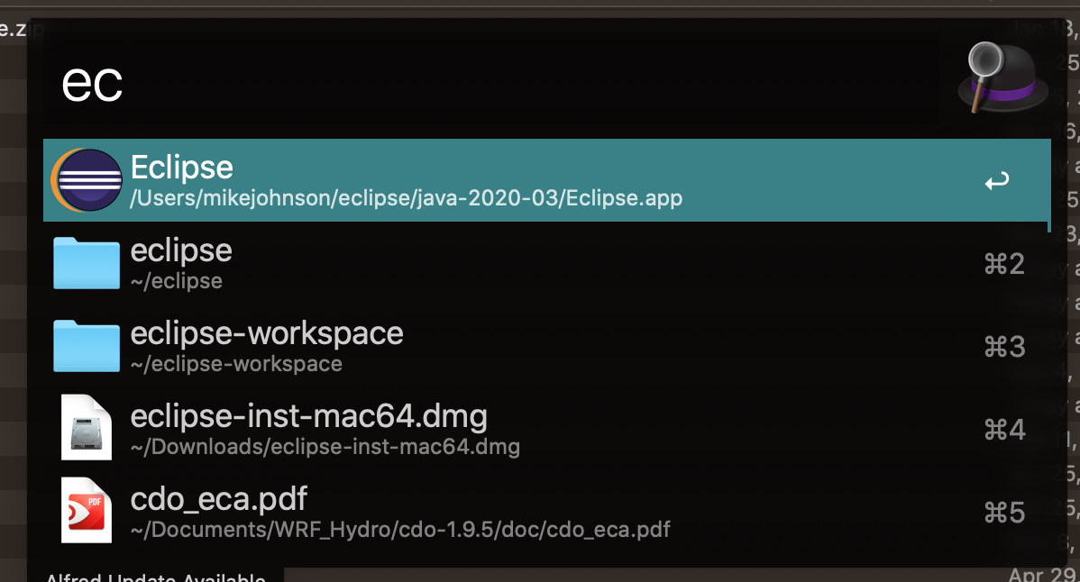
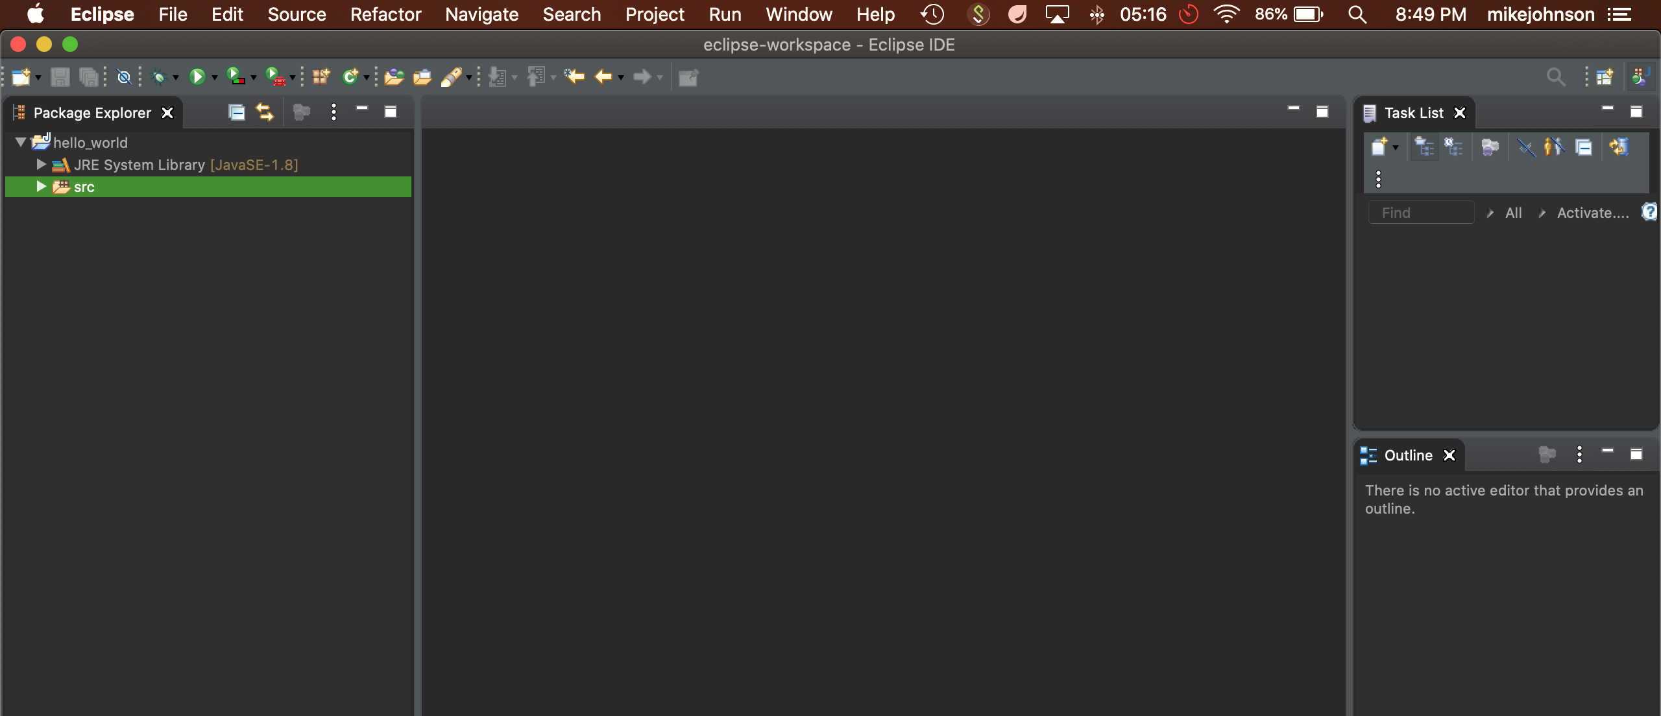
Launch Eclipse !!
Find the application on your machine and launch it. You should see something
SUCCESS !!
https://mikejohnson51.github.io/geog178

Slide 13
3. Introduction to the Eclipse IDE…

Slide 14
Writing, compiling and executing a Program
There are two methods for compiling and running a Java Program. Remember (loosely source code is what you write, source code is compiled, your machine executes compiled code)
Week
1
Getting Started with Eclipse
Using a text editor such as Atom or Notepad, and
your Terminal (Mac) / Powershell (Windows)
This is the approach the textbook takes
Using a dedicated platform such as Eclipse
That is the approach we will use in this class
This is a IDE which stands for an Integrated Development
Environment
IDE’s provide tools for coding, building, running and debugging applications
https://mikejohnson51.github.io/geog178

Slide 15
Setting up a Workspace
Suggestions:
Week
1
On your computer create a new folder called
Getting Started with Eclipse
GEOG178
Think of this folder as a default working directory…
https://mikejohnson51.github.io/geog178

Slide 16
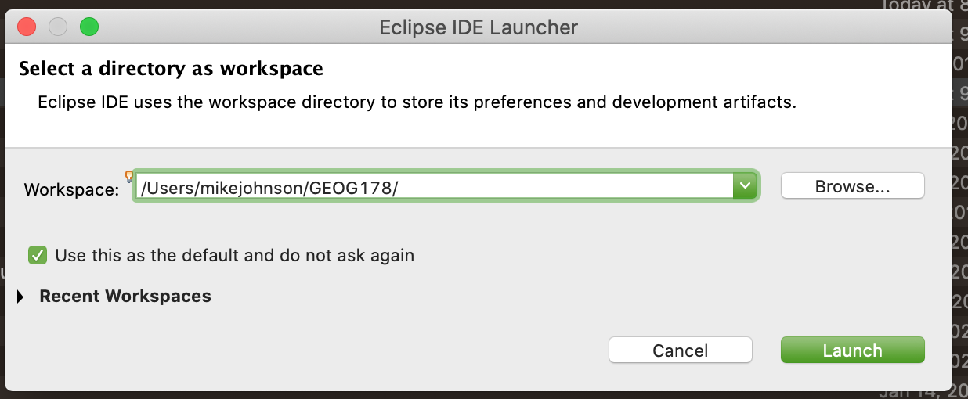
Starting a New Project:
When you launch Eclipse it will ask you to define a
workspace.
Week
1
A workspace is where your source code and output will be stored
Getting Started with Eclipse
Direct your workspace to GEOG178 using the ‘Browse…’ button
Hit ‘OK’ when you are done.
https://mikejohnson51.github.io/geog178

Slide 17
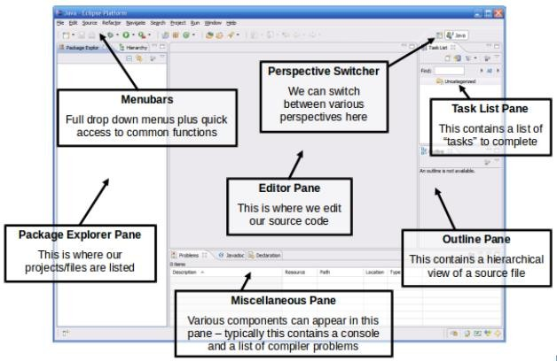
IDE Components:
When your workspace is loaded, you will be presented with the following interface:
Week
1
Getting Started with Eclipse
https://mikejohnson51.github.io/geog178

Slide 18
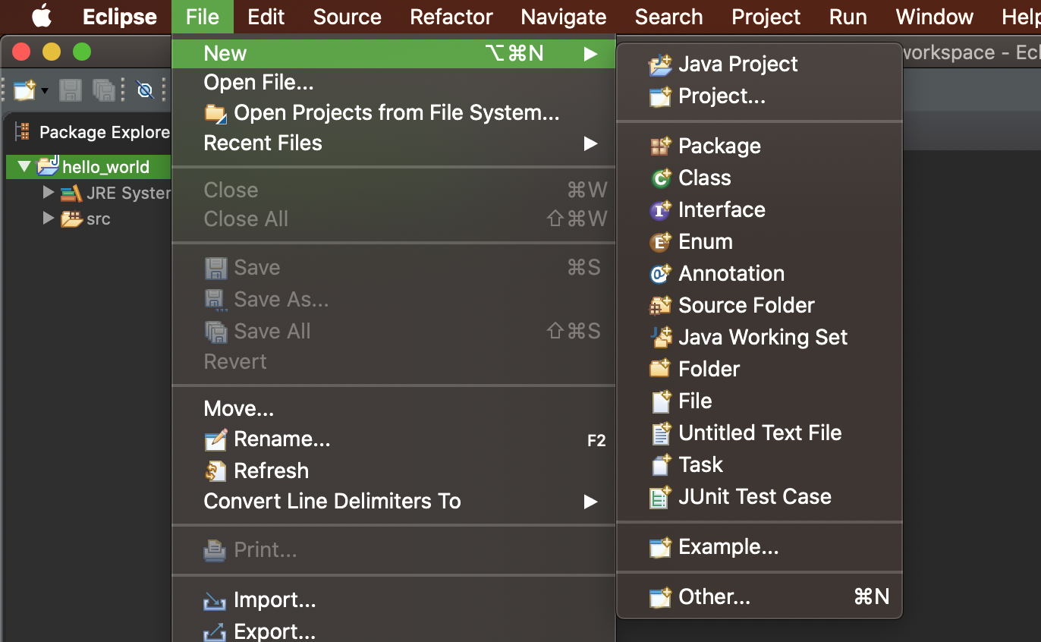
Create a new project
All code in Eclipse needs to live under a project, remember that projects live in workspaces
To create a project: File → New → Java Project
Week
1
Getting Started with Eclipse
https://mikejohnson51.github.io/geog178

Slide 19
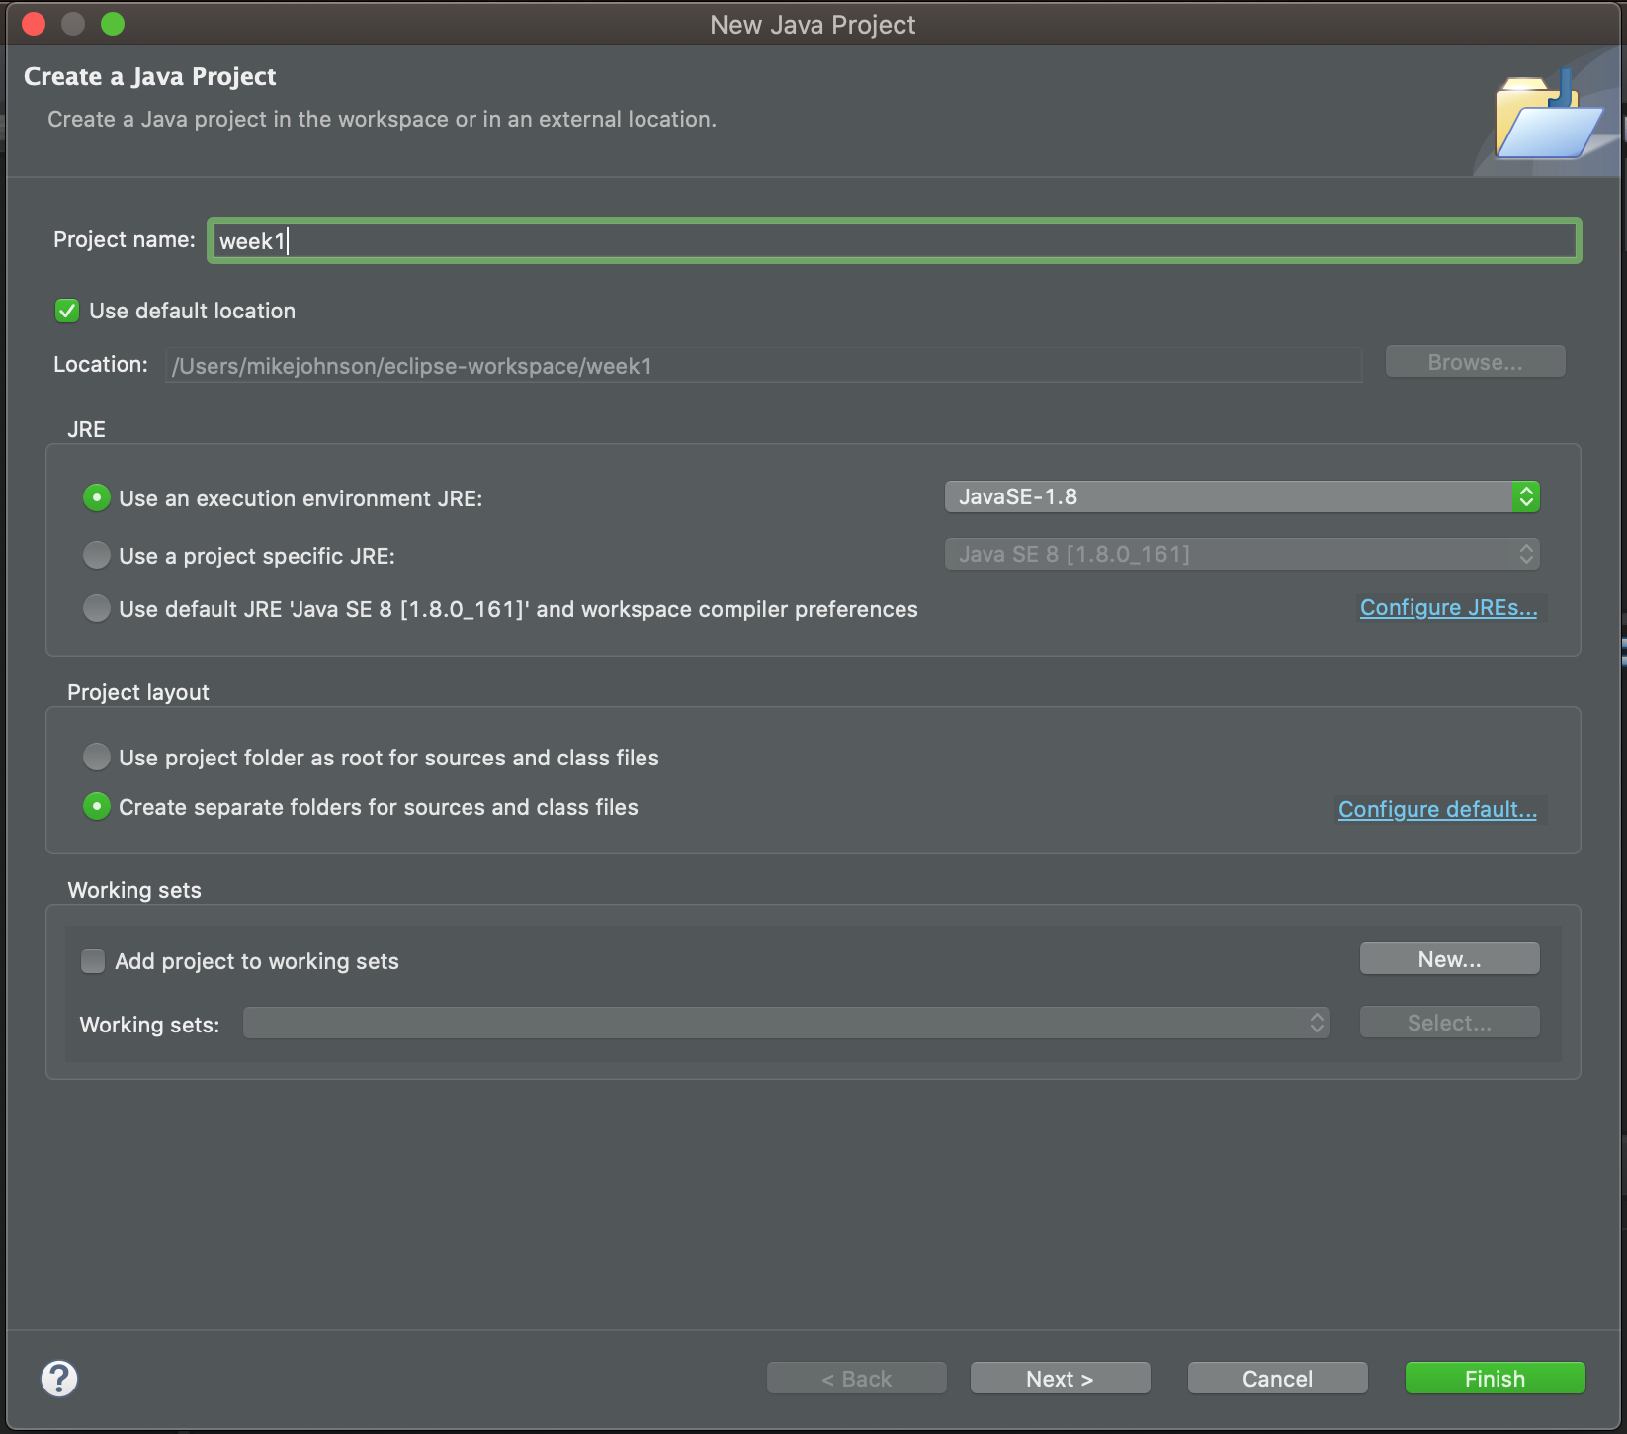
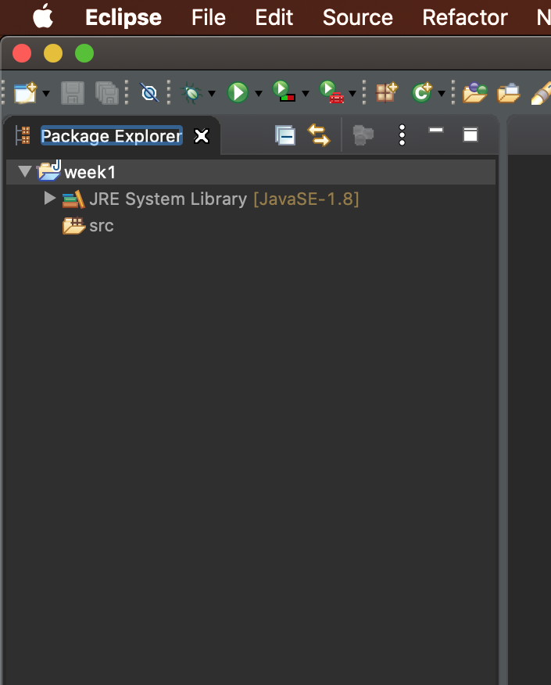
Create a new project
Enter a Name for the Project (week1)
Click “Finish”
The new Project will appear in the Package
Explorer
The src (source) folder is where all your scripts will live before they are compiled!
Week
1
Getting Started with Eclipse
https://mikejohnson51.github.io/geog178

Slide 20
Workspace and Projects (Think of your file paths!)
Workspace
Week
1
Getting Started with Eclipse
/Users/mikejohnson/eclipse-workspace/week1/
Project

Slide 21
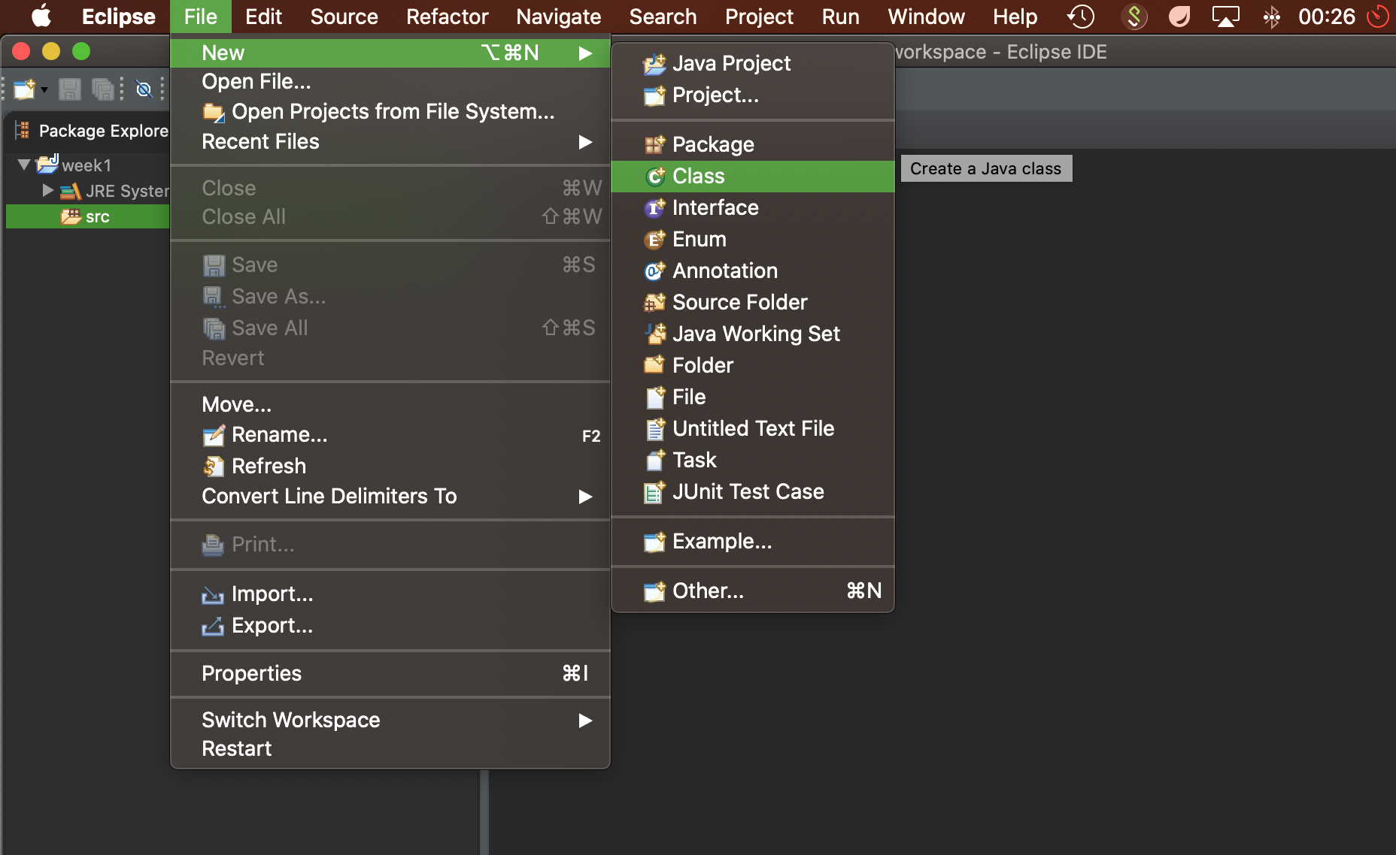
Create a new class
You will now create your first class within the Java Project (that lives in your workspace)
Week
1
Getting Started with Eclipse
https://mikejohnson51.github.io/geog178

Slide 22
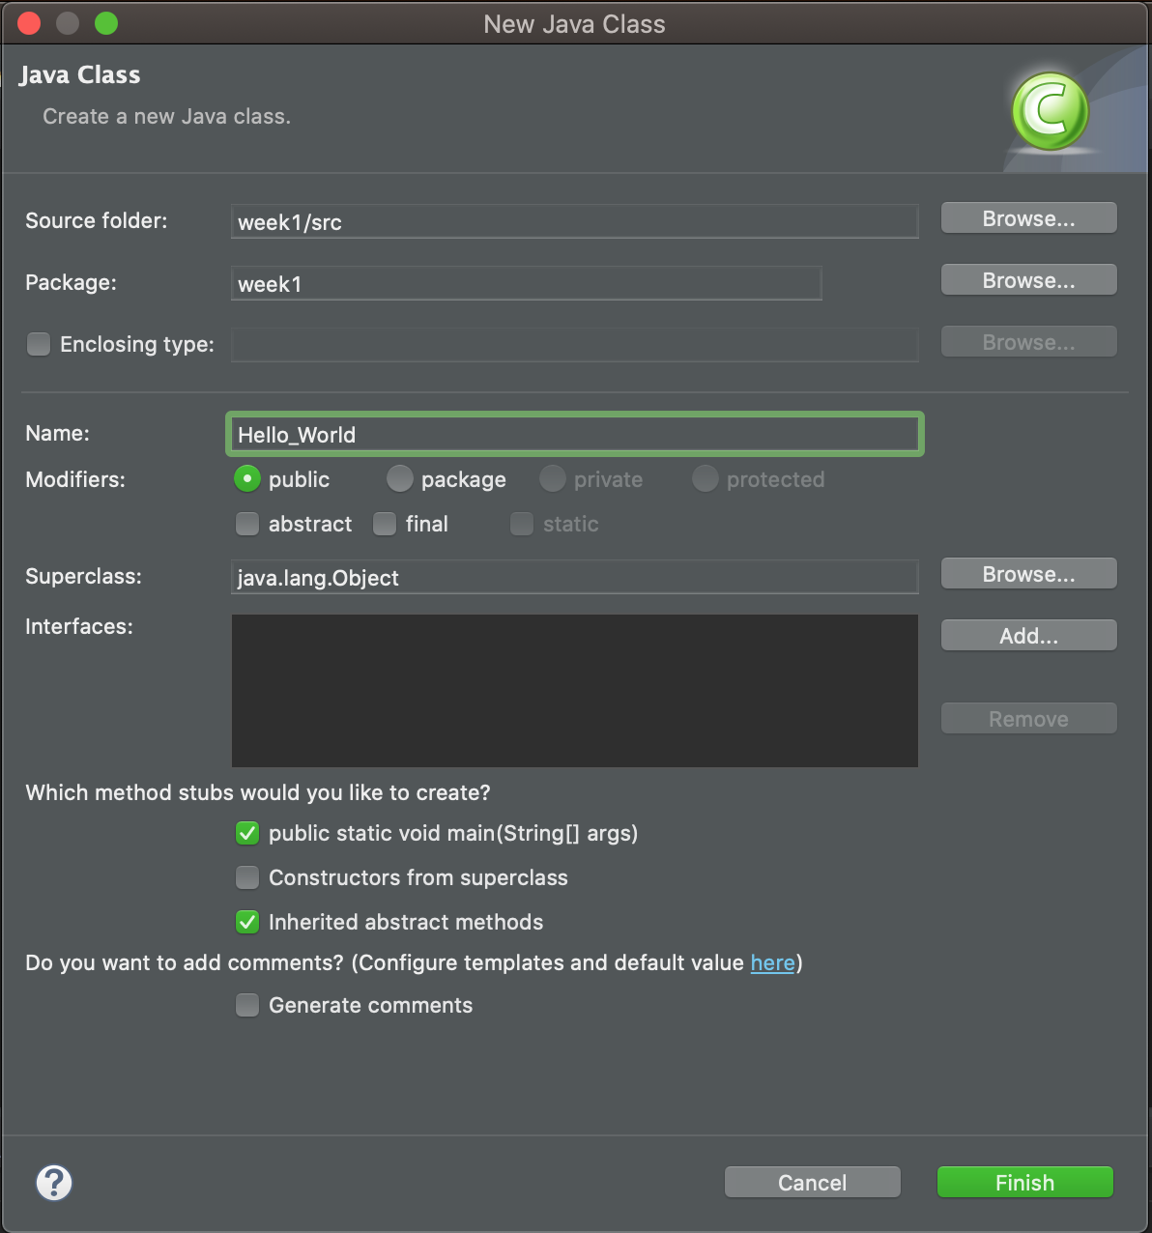
Create a new Class
Enter a Name for the class (Hello_World)
You can also specify:
package
Week
1
Superclass
Whether or not to include a main
Etc..
Ignore these for now…
Getting Started with Eclipse
Fill in necessary information as seen below
Click “Finish”
https://mikejohnson51.github.io/geog178

Slide 23
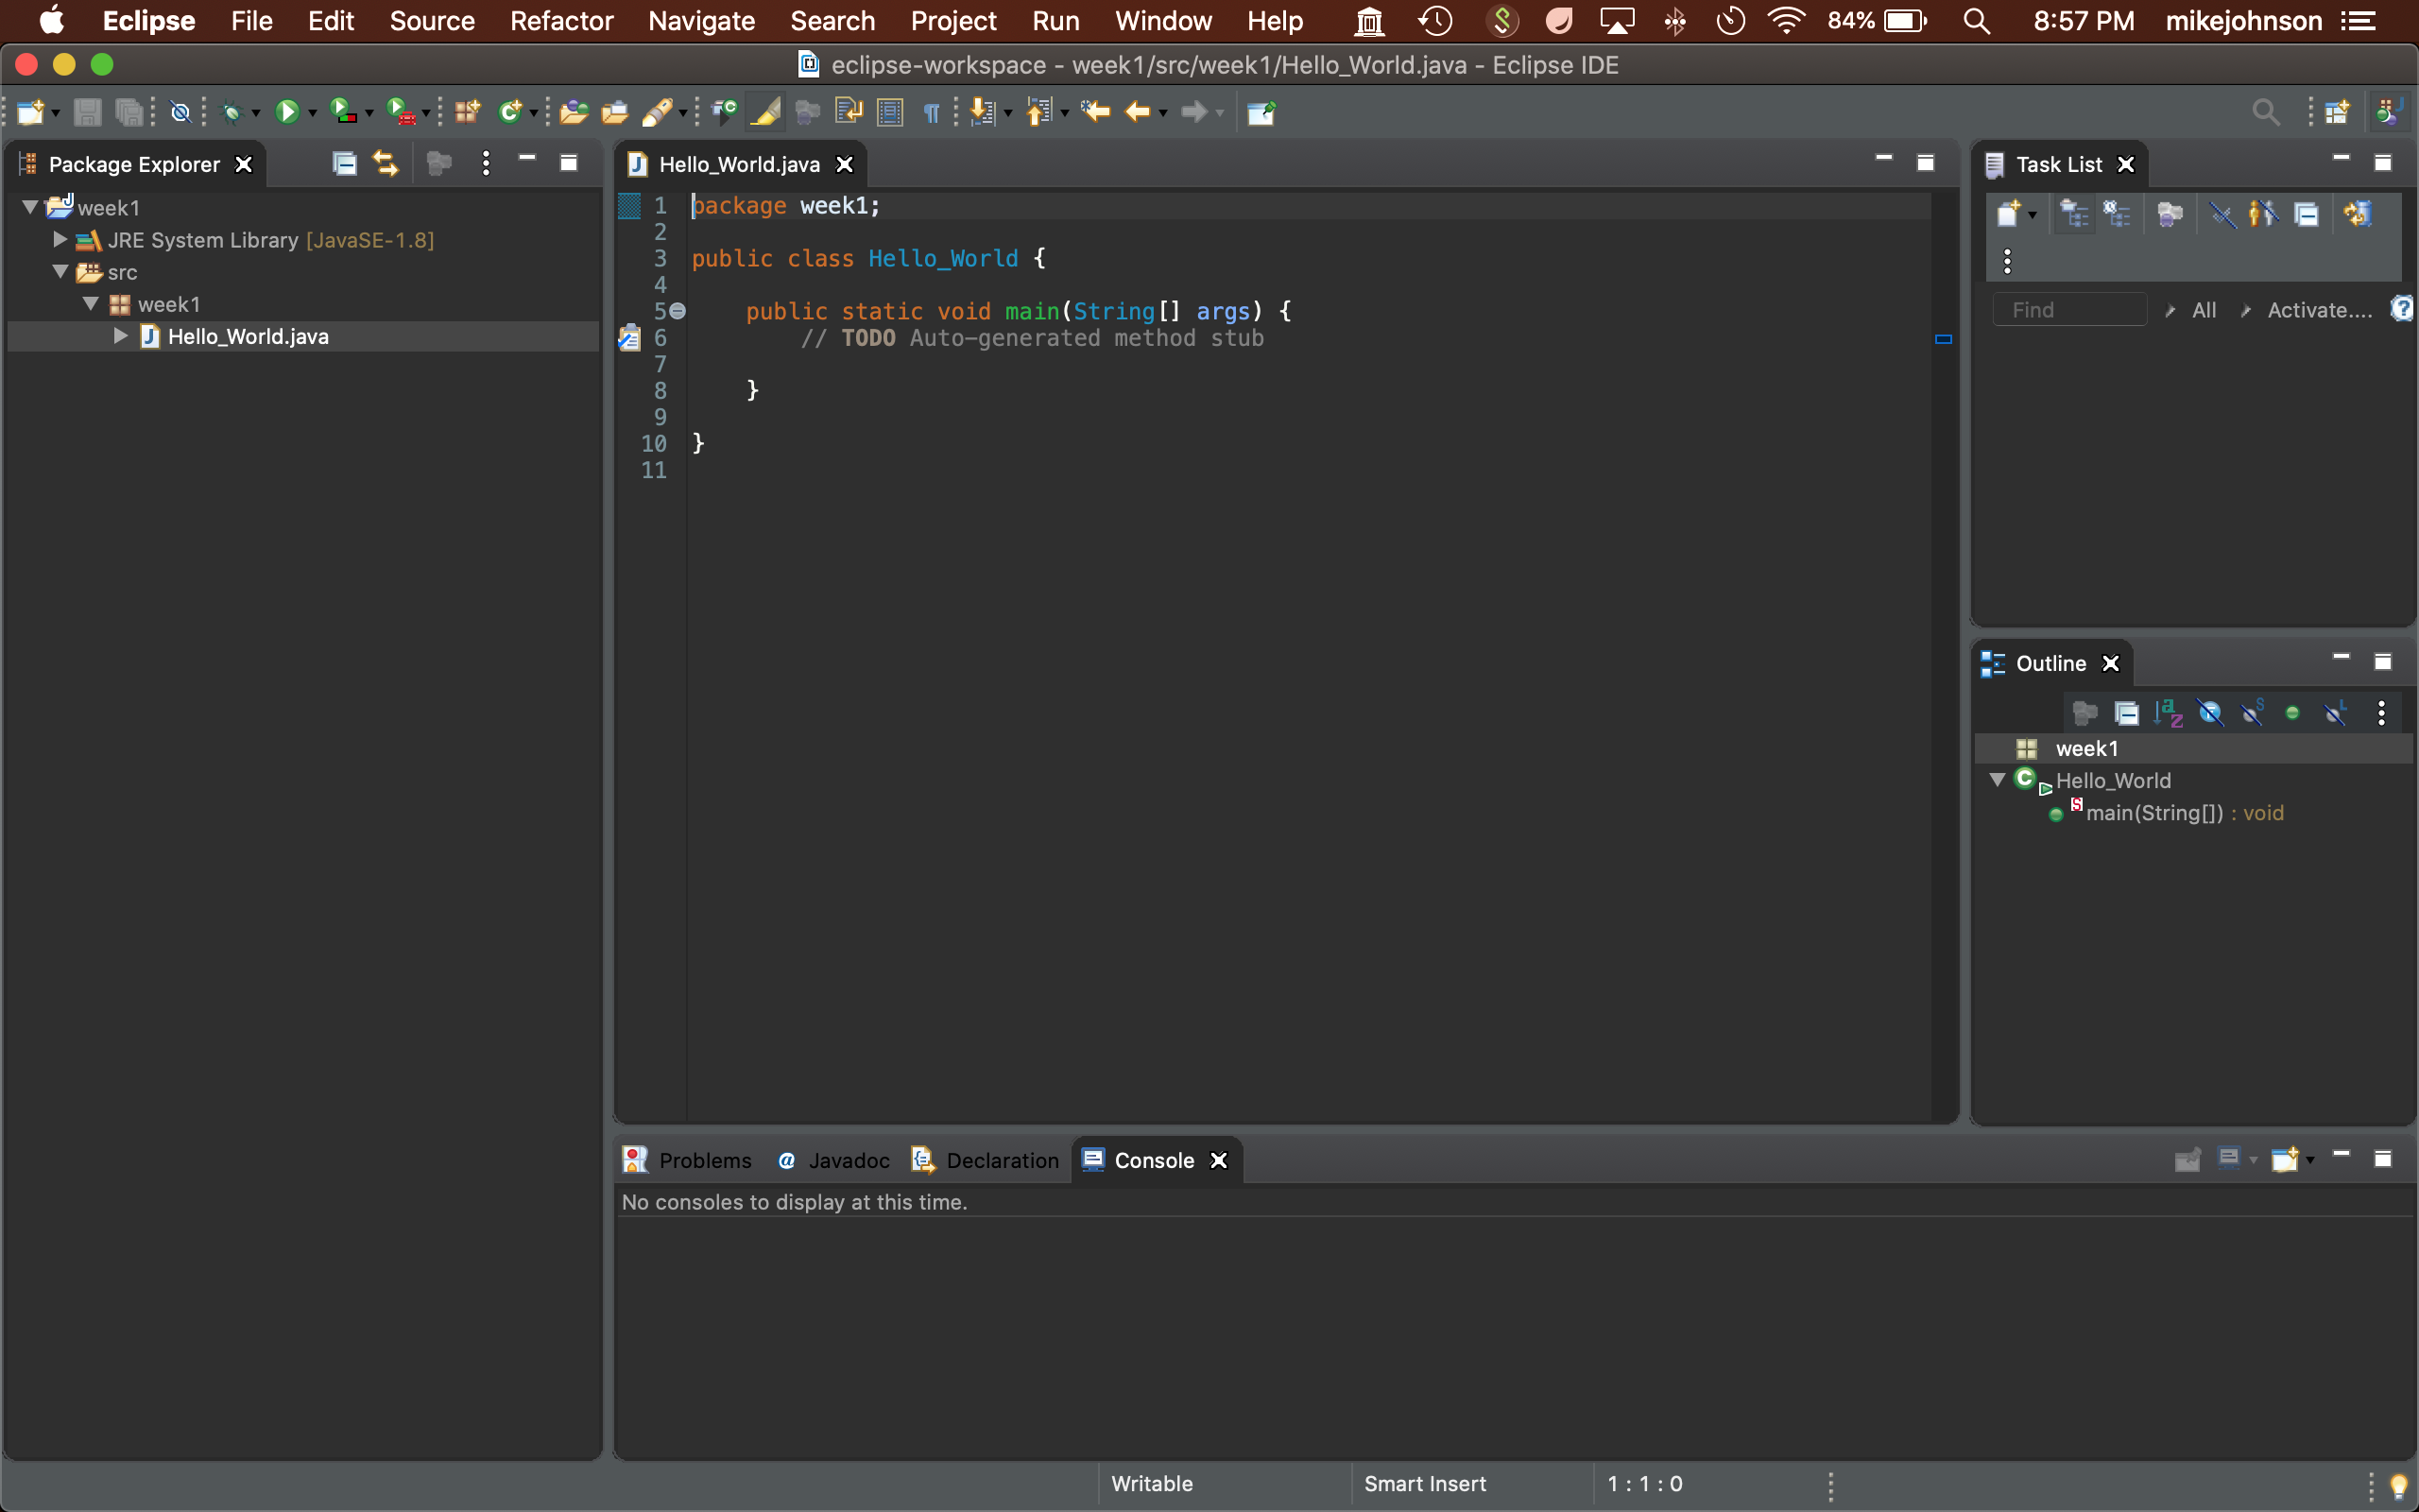
Interface:
You should see the following
Source of the “Hello_World” class is loaded into the editor panel, already stubbed out
Week
1
Getting Started with Eclipse
Directory structure for package and actual java file created automatically
Output will appear here
Source is displayed in hierarchical fashion listing each method name
Be sure to always have your file name match the public class name! (in this case hello_world == hello_world.java

Slide 24
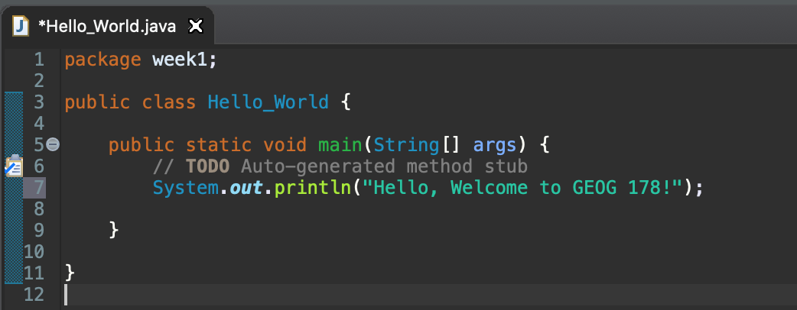
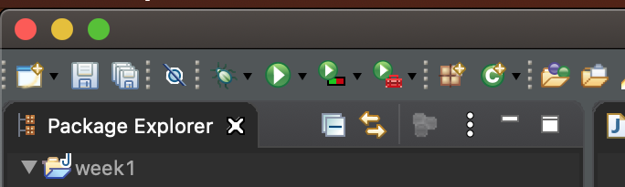
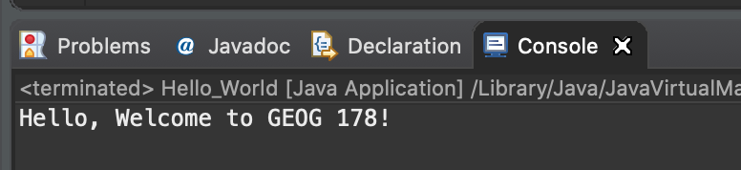
Enter Basic Command
In your program type the command
System.out.println(“Hello, Welcome to GEOG 178!”);
It should look like this:
After typing the code, hit the ‘run’ button:
You should see the following output!

Slide 25
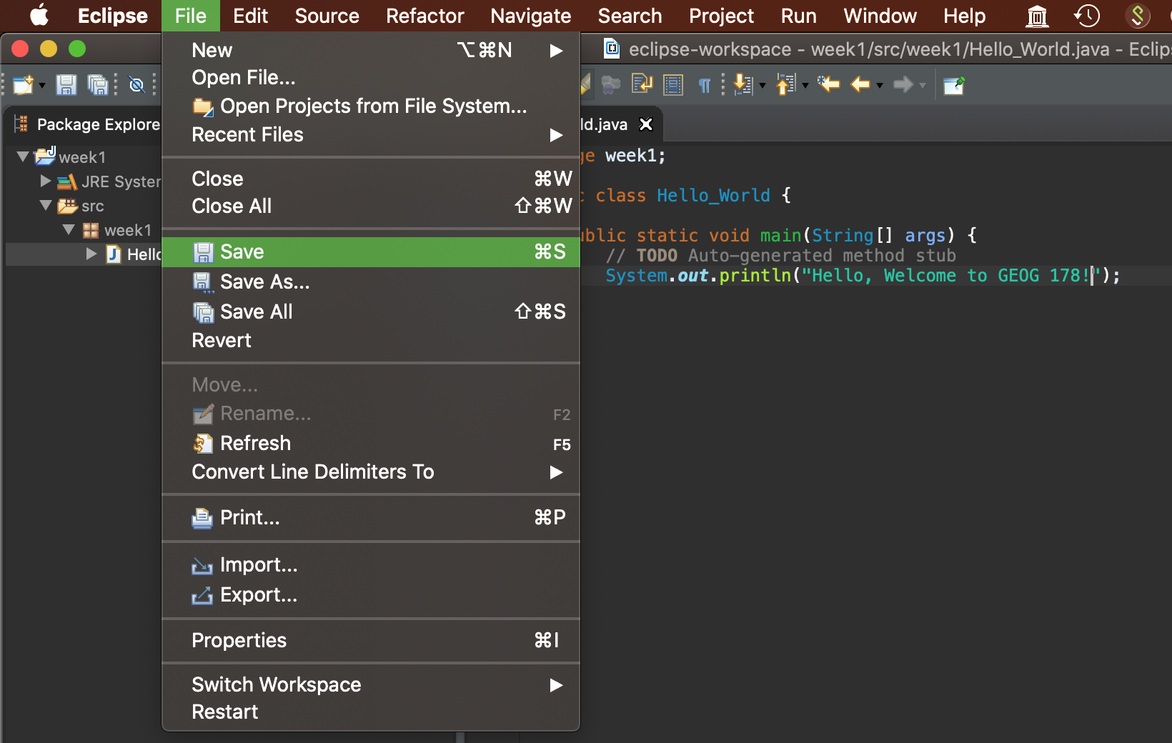
Saving your Program
Running your program will automatically save it
In cases where you want to save manually go:
File → Save
https://mikejohnson51.github.io/geog178

Slide 26
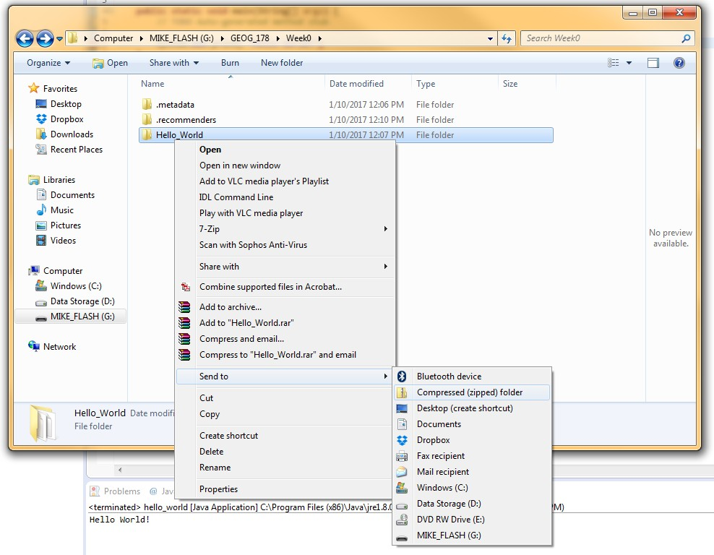
Zip Program Folder
Program files can be zipped to make them smaller and easier to share!
ON WINDOWS:
Go to your flash drive → GEOG_178 → Week0
Right Click on the Folder ‘Hello_World’
Click ‘Send To’ → ‘Compressed (zipped) folder

Slide 27
Zip Program Folder
ON MAC:
Go to your GEOG178
Right Click on the Folder ‘Week1’
Click ‘Compress
You now have a zipped folder that will be easier to share with others!
For lab turn in, you will be able to send me zip files OR share links to a Github repository
https://mikejohnson51.github.io/geog178

Slide 28
Bonus
Read here to learn how to connect a GitHub account/repo to Eclipse:
https://www.vogella.com/tutorials/EclipseGit/article.html
Check out GitHub Desktop for a GUI interface:
https://desktop.github.com
See you Friday at 9:00 am!

